Slide 1
Basic Time Series Analysis
Murthi

Slide 2
Basics: Definitions and Notation
A time series is a collection of observations made sequentially through time
Such observations may be denoted by
Y₁ , Y₂ ,Y₃ , … Y_{t} , … , Y_{T}
observation at time t
since data are usually collected at discrete points in time
The interval between observations can be any time interval (hours within days, days, weeks, months, years, etc).

Slide 3
Examples of time series
Weekly Sales over time
Stock price of a company over time
Malaria incidence or deaths over calendar years
Daily maximum temperatures
Hourly records of babies born at a maternity hospital
Continuous Time series – temperature, air pollution
vs
Discrete Time series – number of road accidents, sales, market shares
Time is discrete – week, month etc.

Slide 4
Objectives of a time series
Description
Merely to describe the patterns over time
Explanation
Can the pattern observed over time be explained in terms of other factors or causes?
Prediction (forecasting)
Can past records help us to predict what will happen in the future?
Improving the past system/behaviour
If factors affecting the behaviour of a variable over time can be identified, action may be taken to improve the system, e.g. action over increasing levels of air pollution

Slide 5
Jumping to conclusions from raw data
Data (interval-scale): Company profits (‘000 dollars)
Objective: To study changes in profit figures over consecutive quarters
Year | Quarter1 | Quarter 2 | Quarter 3 | Quarter 4
1 | 667 | 631 | 675 | 699
2 | 739 | 695 | 751 | 779
3 | 823 | 795 | 835 | 875
4 | 931 | 855 | 939 | 967
Impression is that the 4th quarter is always higher than the 1st quarter
Notes:
4th quarter seems to the busiest but as next slide shows that is an illusion created by the trend effect

Slide 6
Take a look again…
Previous impression is largely because there is a general increase over time
Notes:
You will notice that the activity in the first quarter ( difference between the last quarter of the year and the first quarter figure) shows considerable more activity than a similar difference between the 3rd and 4th quarters , which reflects the activity in the 4th quarter – we will see this more clearly later in the session
For now we just want to keep in mind that when time factor is involved, just looking at the figures might give you a misleading picture

Slide 7
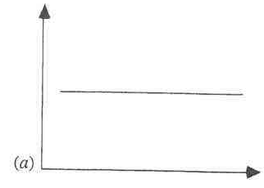
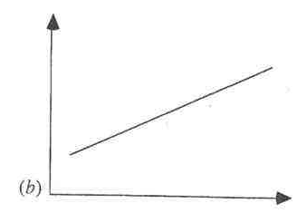
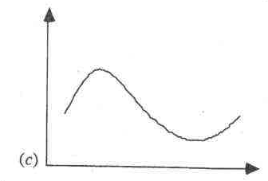
Three Aspects of Time Series Behavior Data: Y_{t} and t
Base level
Trend
Seasonality

Slide 8
The Moving-Average Model
The n-period moving average builds a forecast by averaging the observations in the most recent n periods:
where x_{t} represents the observation made in period t, and A_{t} denotes the moving average.

Slide 9
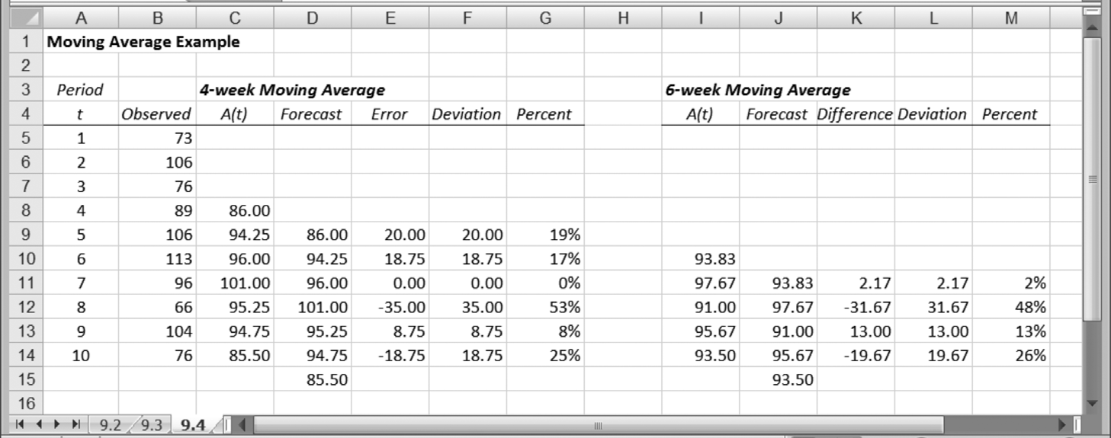
Moving Average Example

Slide 10
Measures of Forecast Accuracy
MSE: the Mean Squared Error between forecast and actual
MAD: the Mean Absolute Deviation between forecast and actual
MAPE: the Mean Absolute Percent Error between forecast and actual

Slide 11
The Exponential Smoothing Model
Exponential smoothing weights recent observations more than older ones.
Where α (the smoothing constant) is some number between zero and one.
S_{t} is the smoothed value of the observations (our “best guess” as to the value of the mean)
Our forecasting procedure sets the forecast F_{t+1} = S_{t}.

Slide 12
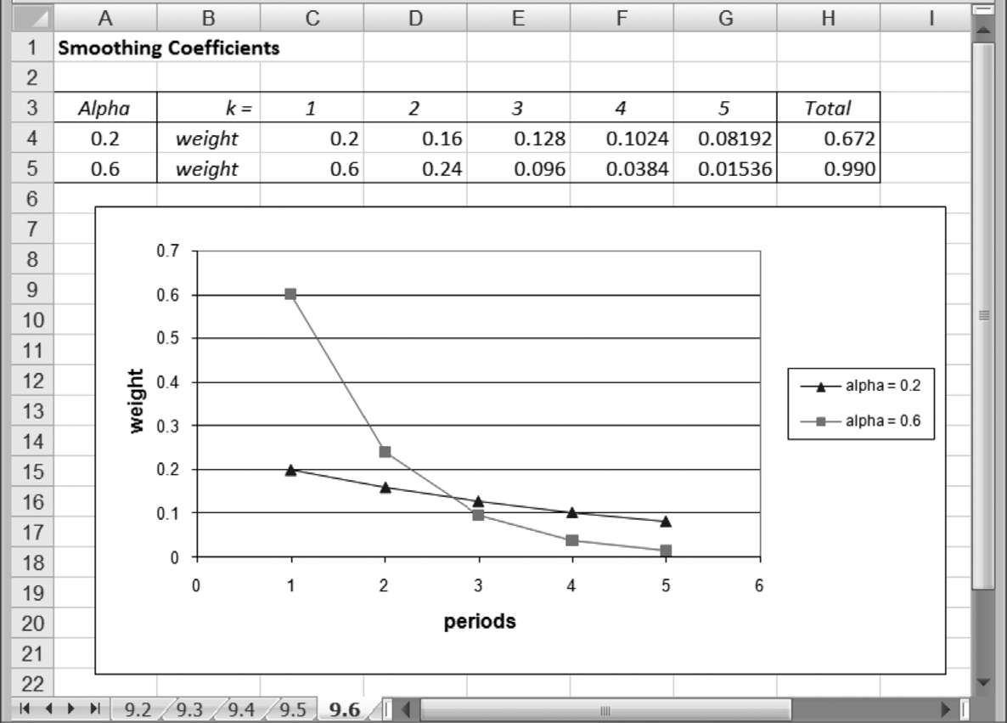
Comparison of Weights Placed on k-year-old Data

Slide 13
Summary
Moving average (MA) and exponential smoothing (ES) models are widely used for routine short-term forecasting.
They assume that the future will resemble the past. That is, no expected changes.
However, the exponential smoothing procedure is sophisticated enough to permit representations of a linear trend and a cyclical factor in its calculations.
Exponential smoothing procedures are adaptive.

Slide 14
Why Time Series?
Modeling an Economic Time Series
Observed y₀, y₁, …, y_{t},…
Time domain: A “process”
y(t) = ax(t) + by(t-1) + …
Autocorrelation (Serial Correlation)
Y_{t} = b’x_{t} + ε_{t}
Cov(ε_{t}, ε_{t-1}) ≠ 0

Slide 15
How to detect autocorrelation?
Durbin-Watson statistic (DW)
Proc reg;
model sales = adv comp / DW;
run;
DW ranges from 0-4
DW 2-4 negative autocorrelation
DW 0-2 positive autocorrelation
DW=2 no autocorrelation

Slide 16
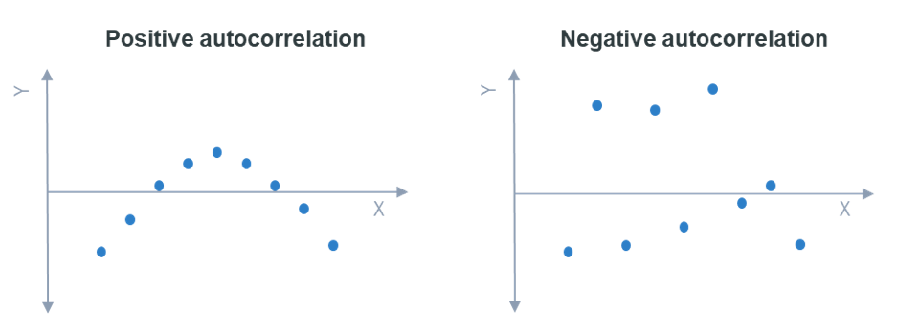

Slide 17
Proc autoreg;
model sales = adv comp / DWprob;
run;
DWprob gives the p-value associated with DW statistic.

Slide 18
Modeling trends
Linear trend model
Y_{t} = c₁ + c₂t
Quadratic trend model
Y_{t} = c₁ + c₂t + c₂t²
Exponential growth curve
Y_{t} = A*exp(c₂t)
Log(Y_{t}) = log(A) + c₂t
Autoregressive trend model
Y_{t} = c₁ + c₂Y_{t-1}

Slide 19
Modeling seasonality
Linear trend model with seasonal dummy variables
Y_{t} = c₁ + c₂t + c₃Season₁ + c₄Season₂ + c₅Season₃
Putting dummy variables for each season

Slide 20
Modeling lags of X variables
S_{t} = a₀ + a₁ A_{t} + a₂ A_{t-1} + a₃ A_{t-2} + ε_{t}
S_{t} = sales at time t
A_{t} = Ad expenditure at time t
Advertising effects last for a long period of time.
Above model is called distributed lag model.

Slide 21
Modeling lags of Y variable
Y_{t} = a₀ + a₁ Y_{t-1} + a₂ Y_{t-2} + a₃ Y_{t-3} + ε_{t}
This is called a autoregressive model (AR)
Y_{t} = a₀ + a₁ ε _{t-1} + a₂ ε _{t-2} + a₃ ε _{t-3} + ε_{t}
This is called a moving average model (MA)
ARMA model has both components.
PROC ARMA

Slide 22
Stationary Time Series
Is the underlying process invariant w.r.t. time?
Yes – then the time series is said to be stationary
Otherwise it is non-stationary.
In a stationary process the mean, variance and covariance are all stationary
If a series is non-stationary, it can be made stationary by first differencing.
i.e. compute y_{t} – y_{t-1} . Test if this variable is stationary.

Slide 23
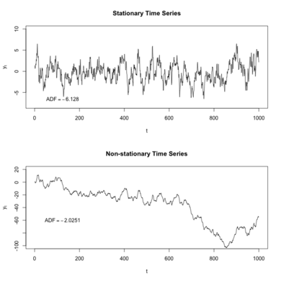

Slide 24
Stationary vs. Nonstationary Series

